Slide 1


WALK & WIN
APP
Every step counts. Every week rewards.
A.UdayTej

Slide 2


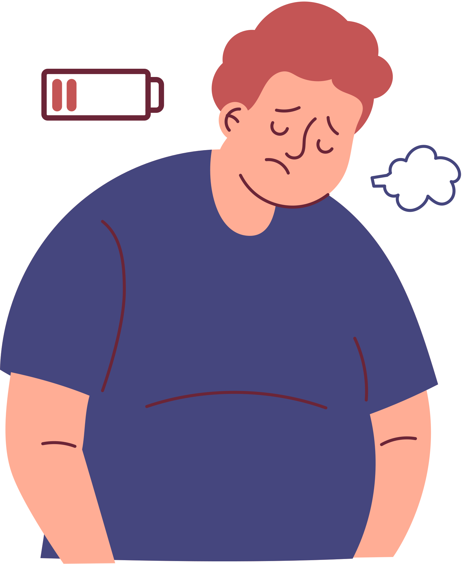



Problem Statement
THIS HAPPENS DUE TO A LACK OF STRUCTURE, LOW MOTIVATION
AS A RESULT, THEY FACE DECLINING PHYSICAL HEALTH,
WORK-FROM-HOME PROFESSIONALS OFTEN
STRUGGLE TO MAINTAIN
HEALTHY ROUTINES

Slide 3


MARKET ANALYSIS – WHAT USERS ARE SAYING
User Behavior & Habits | pain points | User Goals & Priorities
🏃‍♂️ Exercise Frequency (12K surveyed): 19% Daily 35% 3–4 week 23% Occasionally 23% Never 🍽️ Eating Style (11K): 51% eat a mix of healthy & unhealthy 💬 Health Tracking (11K): 52% just “look in the mirror” — no ideal app available | 🍕 48% face cravings (8.7K responses) 🏋️ 48% say exercising regularly is hardest (13K responses) 66% do not exercise daily (2.8K responses) | 31% want to lose weight (9.8K responses) ❤️ 61% prioritize health over career, relationships, and fun (11K responses) 😓 48% say exercise is best stress relief (9.2K responses)

Slide 4



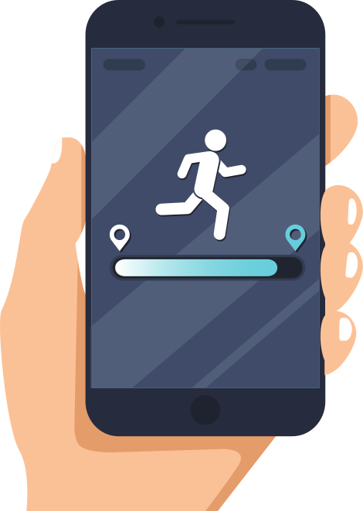

POSITION STATEMENT
THAT TRACKS STEPS, EVALUATES MEALS, AND REWARDS CONSISTENT HABITS WITH REAL-LIFE INCENTIVES LIKE DISCOUNTS AND HEALTHY RECIPES
UNLIKE GENERIC FITNESS TRACKERS OR CALORIE COUNTERS,
FOR WORK-FROM-HOME PROFESSIONALS AND HEALTH-CONSCIOUS INDIVIDUALS
WHO STRUGGLE TO STAY ACTIVE, EAT HEALTHY, AND STAY MOTIVATED

Slide 5

USER PERSONA
01
ARAVIND – BUSY TECH PROFESSIONAL, 34, HYDERABAD
Background:
Aravind works full-time from home as a project manager in a tech company. With long work hours and back-to-back meetings, his eating habits have become chaotic and unplanned.
Lifestyle & Behavior:
Eats whatever is available or quick to order — often without realizing what went into the meal
Wants to eat healthy but doesn’t know how or where to begin
Tried multiple apps and YouTube channels, but found them confusing, overwhelming, or too generic
Often forgets to log meals or track nutrition due to busy schedules
Pain Points:
❌ Doesn’t know what’s healthy and what’s not in his daily diet
❌ Finds it hard to plan meals or follow complex recipes
❌ Can’t find personalized, Indian-style healthy meal videos or suggestions
❌ Most apps feel built for “fitness people” — not realistic for his work routine

Slide 6

USER PERSONA
02
SINDHU – HR DEPARTMENT 32, NAGPUR
Background:
Sindhu works in HR for a mid-sized company. She’s tried to build a fitness routine multiple times but can never stick with it. Her routine breaks after a week or two because she’s not sure what to do next.
Lifestyle & Behavior:
Starts exercising with good intention, but drops off after 5–7 days”
Watches random YouTube warm-up or workout videos but feels confused or unsure if she’s doing them right
Doesn’t have a personal trainer, and most workout apps are either too intense or unrelatable
Pain Points:
❌ Lacks motivation to stay consistent
❌ Doesn’t know where to start or how to structure a beginner-friendly workout plan
❌ No guidance on form, routine, or progress tracking
❌ Feels there’s no reward or result, so gives up early

Slide 7

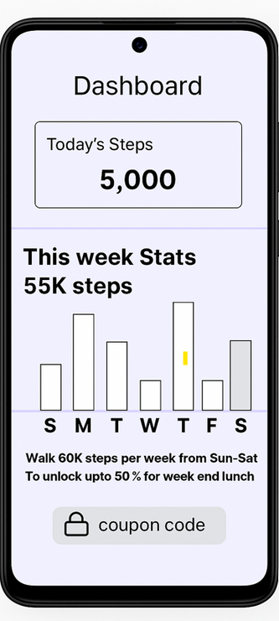
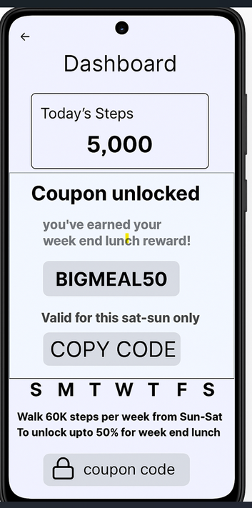



SOLUTIONS
1. STEP TRACKER + REWARDS
Tracks daily and weekly steps
Encourages weekly consistency (e.g., 60K steps per week unlocks reward)
Offers weekend meal discount coupons (BIGMEAL50)
Pain Points Solved:
Motivation to walk more with real-world benefits
Consistency through weekly targets
Gamified experience that feels rewarding

Slide 8
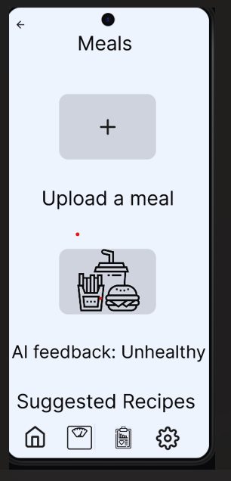
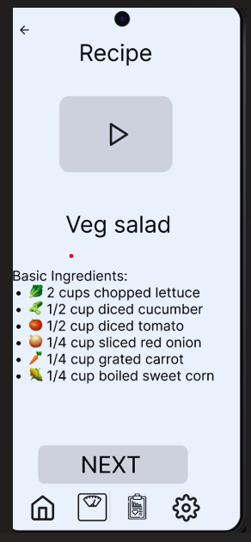
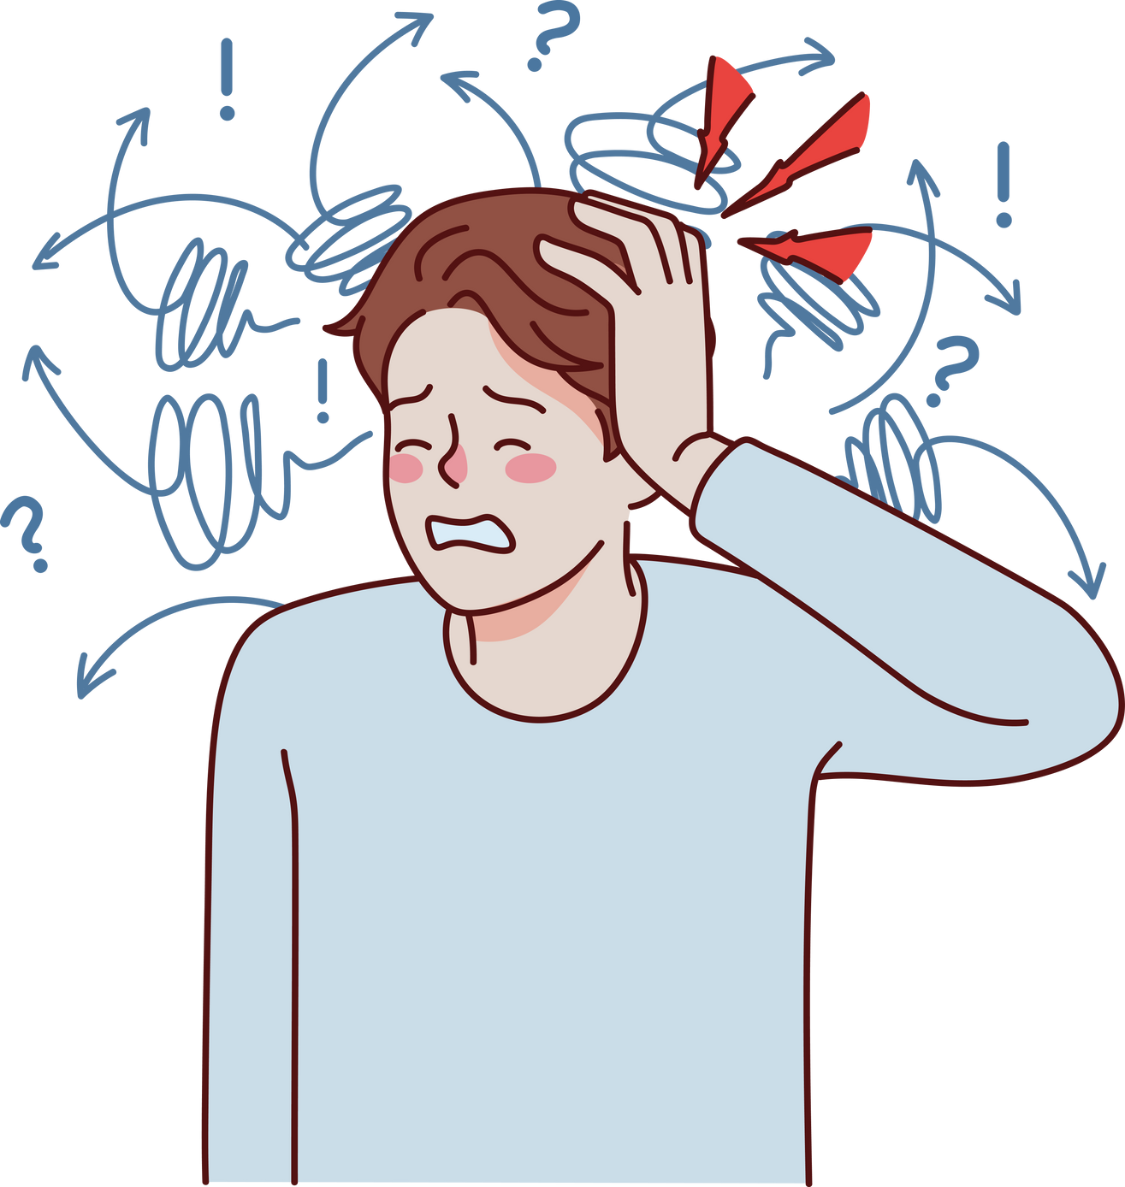

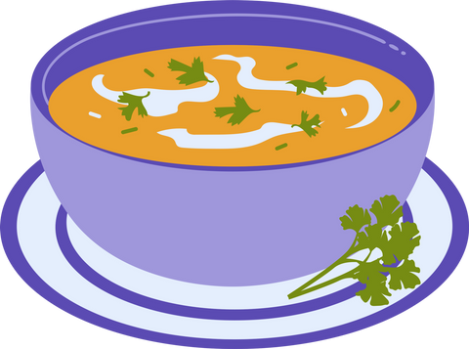

SOLUTIONS
2. MEAL LOGGING + AI FEEDBACK +RECIPE GUIDANCE
User uploads a photo of a meal
AI gives feedback like “Unhealthy”
Triggers Suggested Recipes to improve diet
Pain Points Solved:
Users unsure if they’re eating healthy
No need to manually enter nutritional data
AI removes confusion and encourages better food choices

Slide 9
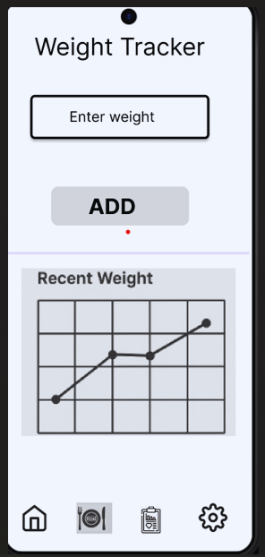
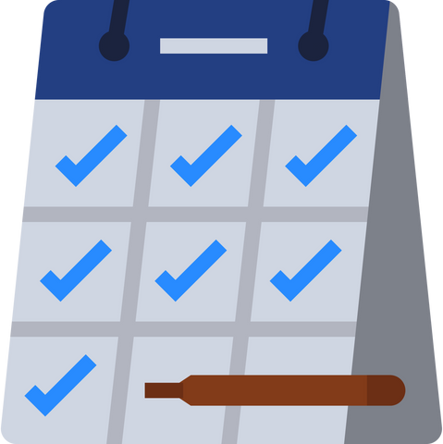

SOLUTIONS
4. WEIGHT TRACKER
Easy weight entry
Graph shows weight trend over time
Pain Points Solved:
Encourages users to stay consistent
Visually shows progress (no pressure to lose fast))

Slide 10
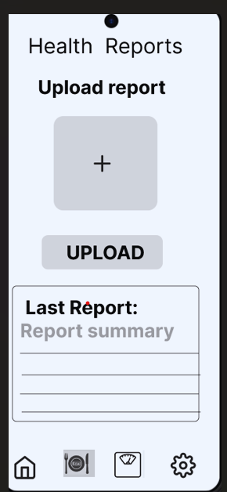
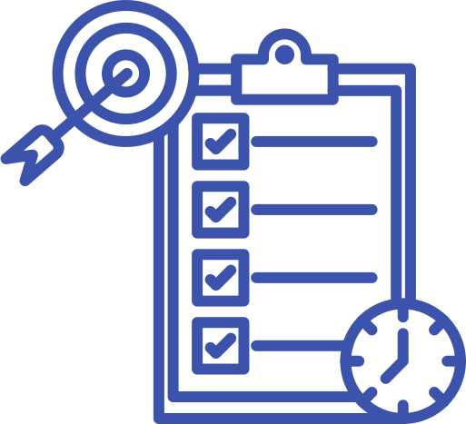

SOLUTIONS
5.HEALTH REPORT UPLOAD
Upload past reports
Show last checkup summary
Pain Points Solved:
Tracks long-term wellness
Useful for users with medical history (e.g., diabetes, weight gain)

Slide 11



KEY PRODUCT METRICS (KPIS)
1.Adoption & Engagement Metrics:
Daily Active Users (DAU):
This tells how many users open and use your app each day. It shows if people are forming a habit.
Weekly Active Users (WAU):
This tracks how many users are active each week. It helps you understand if users keep coming back.
Day 1 & Day 7 Retention:
This shows how many users return the next day and after one week. It tells if users find the app useful early on.
Feature Adoption Rate:
This tracks how many users use different features like step tracking or meal uploads. It helps you see which features are popular or ignored.
2. Behavior & Success Metrics
Average Steps per Day:
Shows how much users are walking daily. It reflects their activity level and physical improvement.
Meal Uploads per Week:
Counts how often users upload photos of their meals. More uploads mean they’re engaged and tracking eating habits.
Weight Log Consistency:
Tracks how often users log their weight. Consistent logging means they’re committed to their health journey.
Health Report Uploads:
Shows how many users upload their checkup reports. This reflects long-term care and trust in the app.

Slide 12
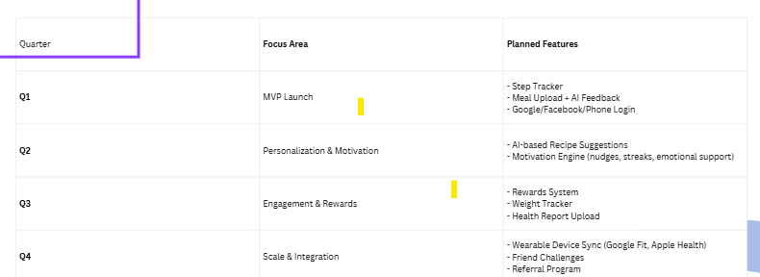
Walk & Win – Product Roadmap

Slide 13
CONCLUSION
Walk & Win is more than a fitness app — it's a daily wellness companion that
motivates users to move, eat better, and feel rewarded for every healthy habit.
We’ve designed it to be:
✨ Simple to use
🎯 Focused on consistency, not perfection
💡 Built for busy, real-life users who need gentle

